Slide 1

Moderna: Programming the Medicine of the Future with mRNA
A Case Study in Digital Biology & AI-Driven Biotech Innovation

Slide 2
The Roadmap Ahead
Moderna operates more like a technology company than a traditional pharmaceutical firm — their approach is fundamentally digital, data-driven, and built on iterative design cycles.
01
02
The mRNA Digital Platform
Code to Cure Workflow
Understanding the foundational technology that enables programmable medicine
How digital biology transforms genetic sequences into therapeutic interventions
03
04
AI Integration & Success Stories
Market Impact & Future Vision
Machine learning accelerating discovery and clinical outcomes
Challenges navigated and the expanding pipeline ahead

Slide 3
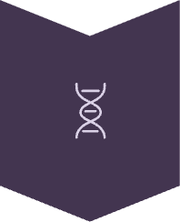
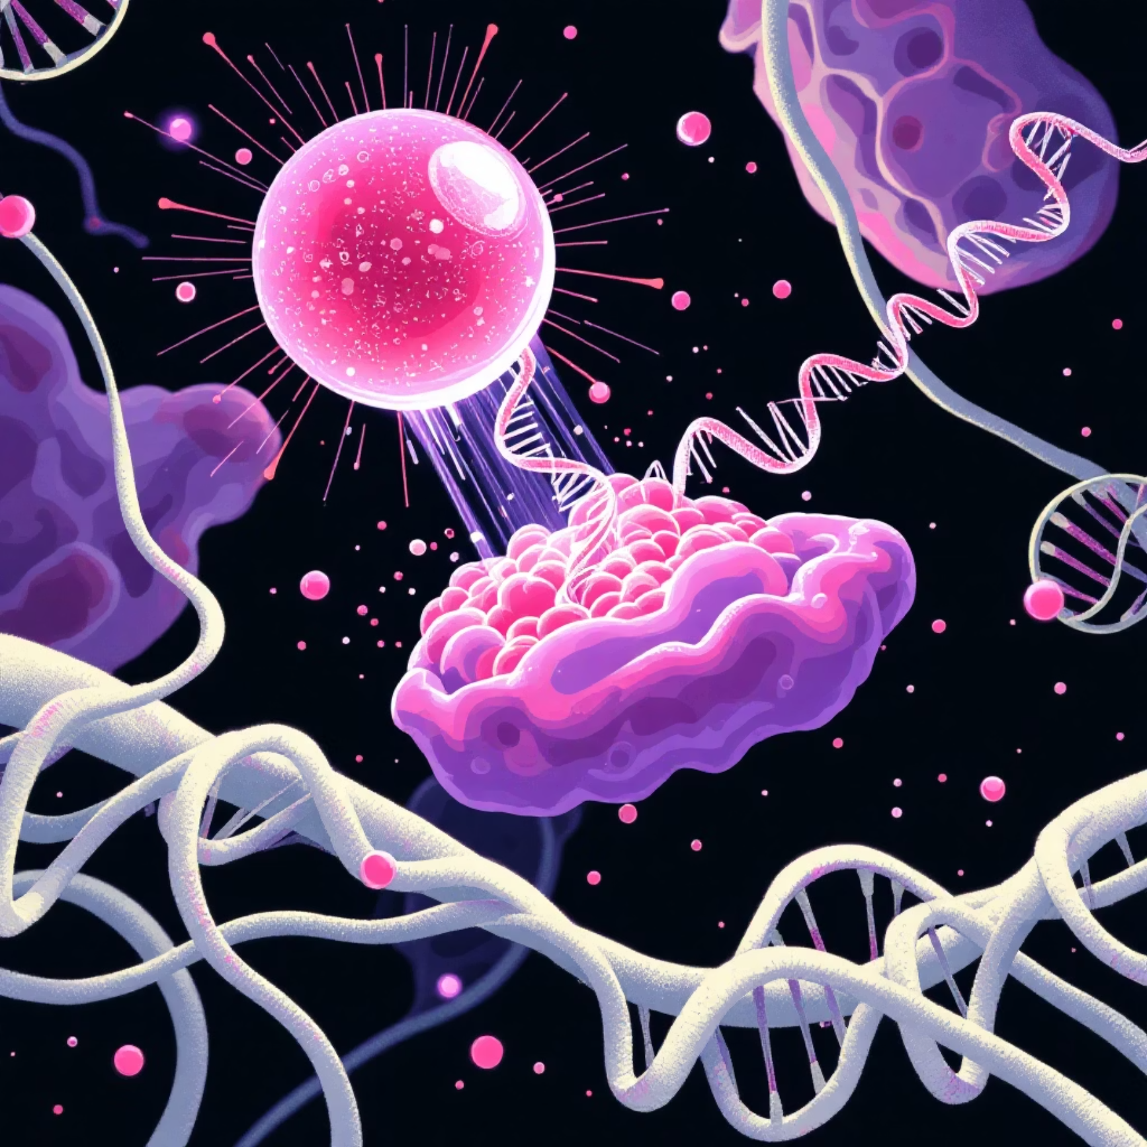

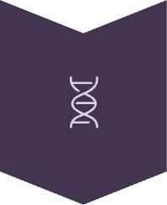
Turning the Body into a Drug Factory
mRNA therapeutics represent a paradigm shift — instead of manufacturing drugs externally, we teach the body's own cells to produce the medicine they need.
Design
Scientists code a precise mRNA sequence targeting a specific protein
Deliver
Packaged in lipid nanoparticles (LNPs) and safely injected into patients
Produce
Body's cells generate the protein, triggering precise immune responses
Platform Advantage: The same foundational process can target multiple diseases by simply changing the genetic code — it's biology as software.

Slide 4
A Software-Like Development Cycle
Moderna's workflow mirrors the iterative, data-driven processes of software engineering — every experiment generates insights that improve the next version.
Target Identification
1
Mining genomic databases to identify disease-specific targets
AI-Driven Sequence Design
2
Machine learning optimises mRNA for maximum expression and stability
Smart Formulation
3
AI designs effective lipid nanoparticle carriers for delivery
Clinical Testing
4
Rigorous pre-clinical and human trials validate safety and efficacy
Digital Manufacturing
5
Automated, data-optimised production pipelines ensure quality

Slide 5
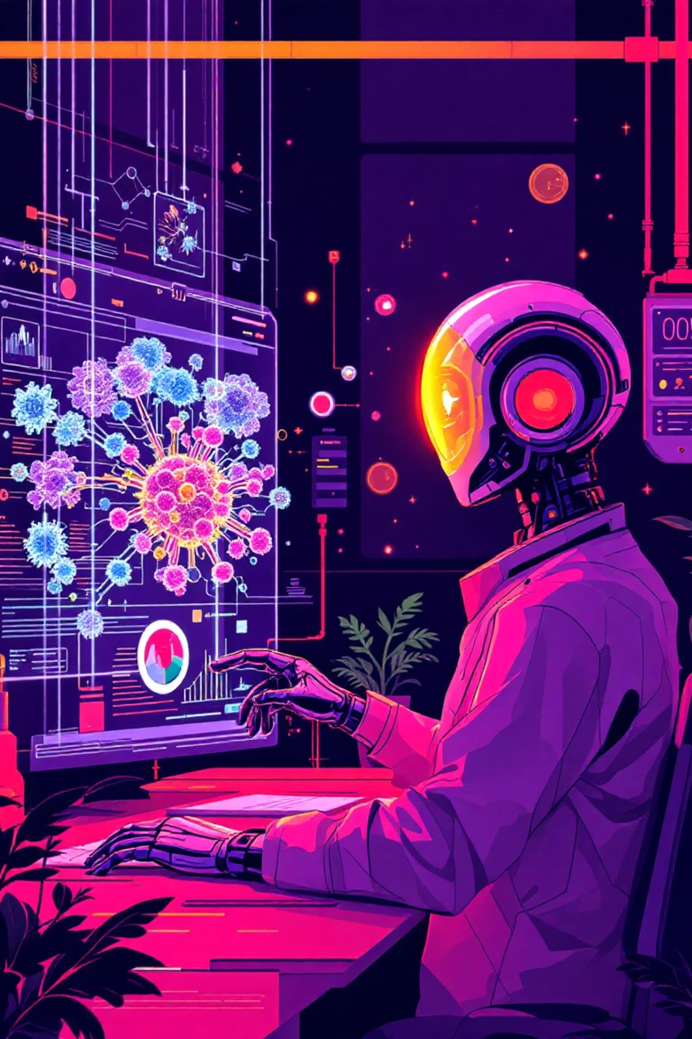




Data Science is in Moderna's DNA
Artificial intelligence and machine learning aren't just tools at Moderna — they're embedded into every layer of the innovation stack, from molecular design to clinical deployment.
mRNA Optimisation
Natural language processing-inspired models enhance sequence stability, translation efficiency, and protein expression levels
Generative AI for LNPs
Deep learning designs novel lipid carrier formulations entirely in silico, dramatically accelerating discovery
Digital Bioreactors
Reinforcement learning algorithms continuously optimise manufacturing yield, purity, and consistency
Clinical Intelligence
Patient data modelling improves trial design, endpoint selection, and predicts treatment success rates

Slide 6

From Sequence to Clinic in 63 Days
Moderna's digital-first platform enabled unprecedented speed in responding to the COVID-19 pandemic — a timeline that redefined what's possible in vaccine development.
10 January 2020
1
SARS-CoV-2 genome sequence publicly released by Chinese researchers
2
13 January 2020
Moderna finalises mRNA-1273 vaccine design — just 3 days later
7 February 2020
3
First clinical batch manufactured and quality-tested
4
16 March 2020
First human trial dose administered, beginning Phase 1 trials
This 63-day timeline represents a historic achievement — made possible because Moderna didn't need to grow or handle the actual virus. They simply needed its genetic code, demonstrating the revolutionary power of digital biology.

Slide 7
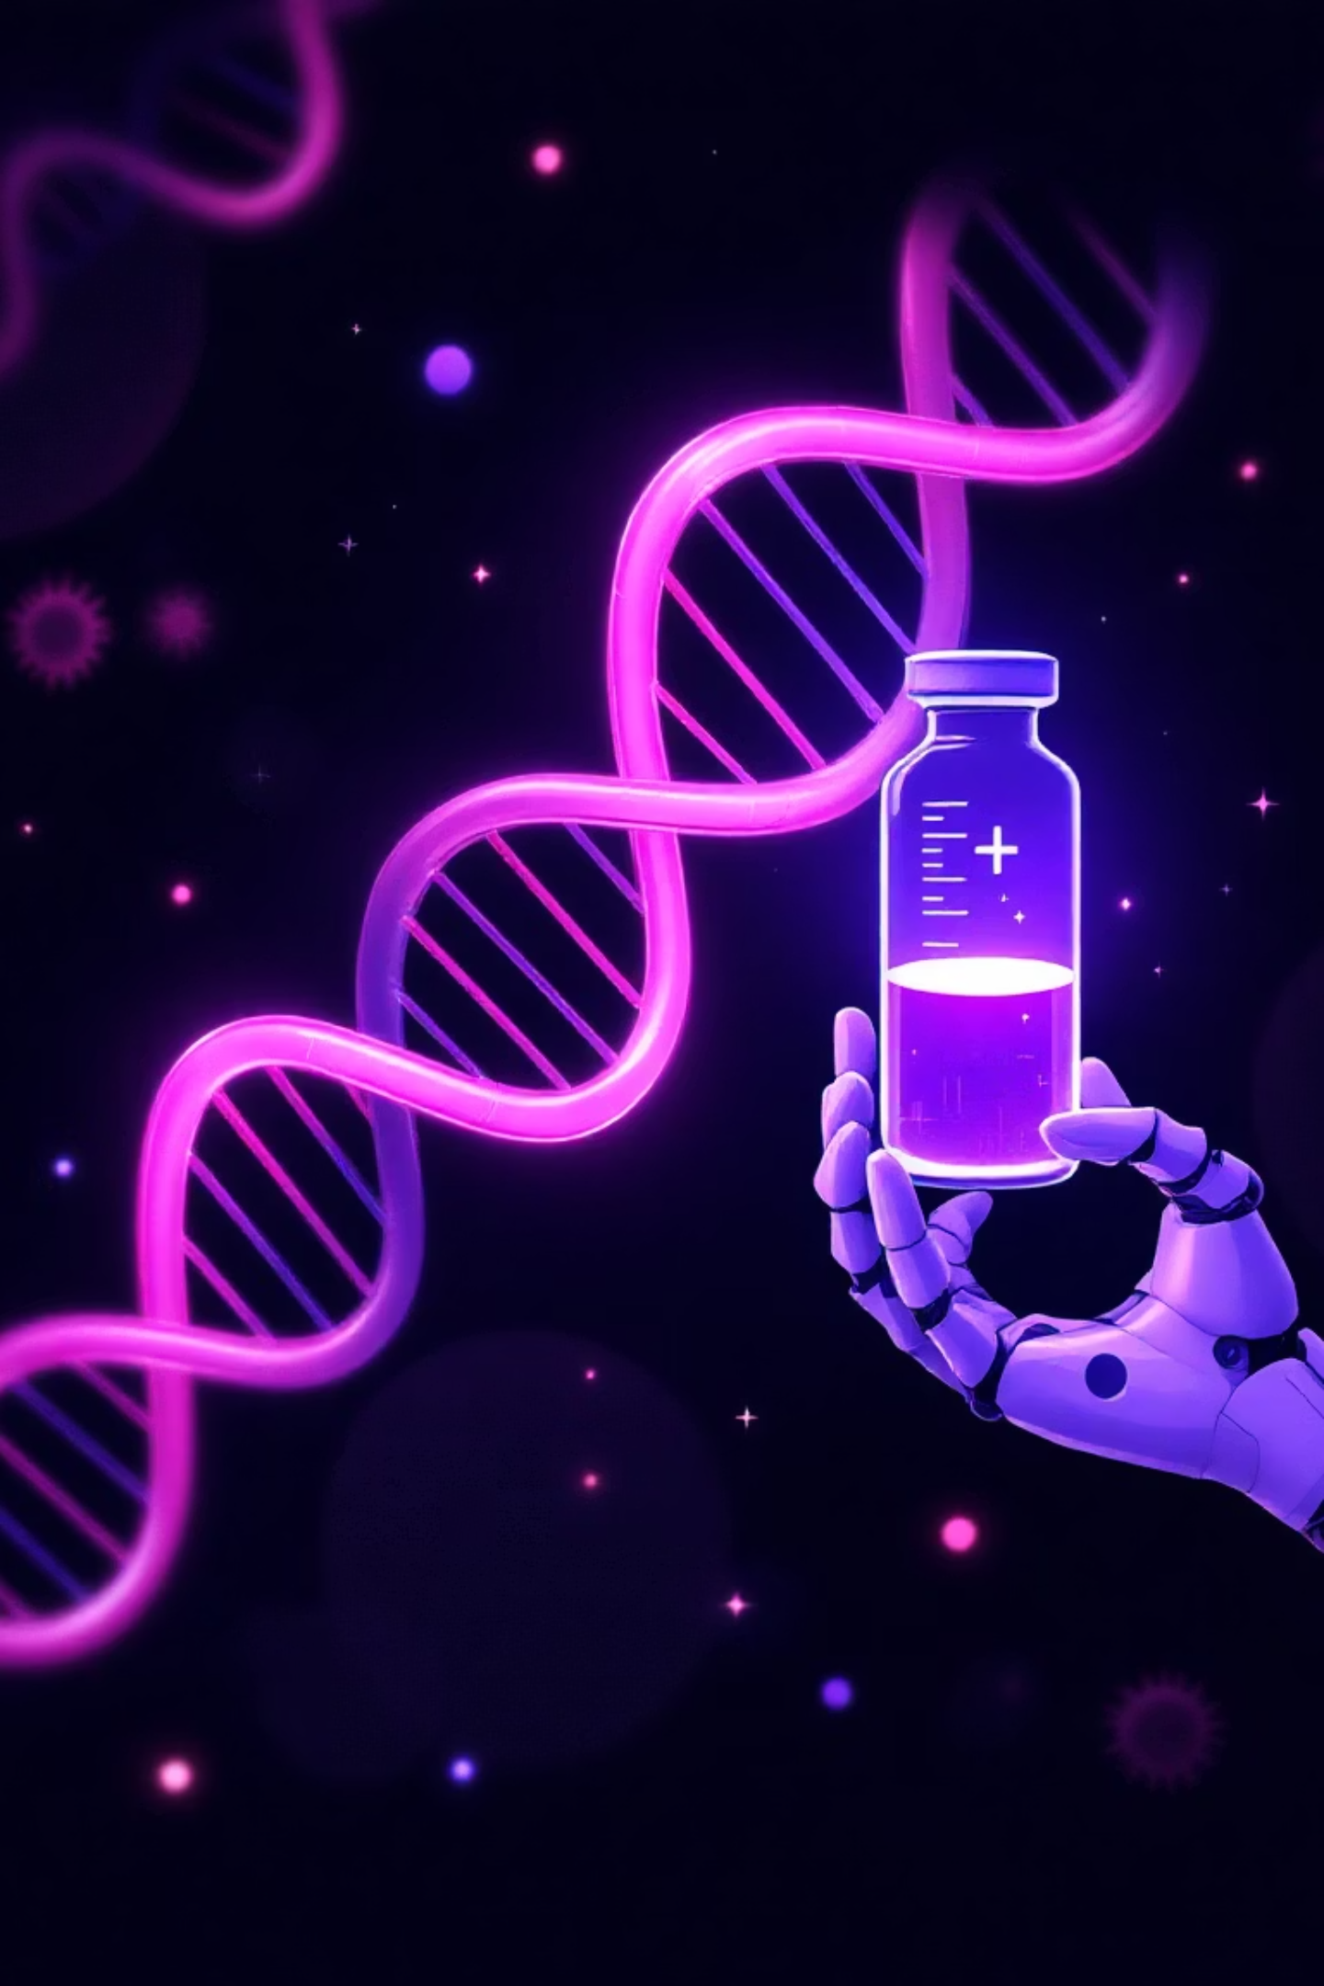




A Truly Personalised Therapeutic
Cancer vaccines represent the next frontier — where AI enables treatments tailored to each individual patient's unique tumour biology.
Sequence Patient's Tumour
Comprehensive genomic analysis of both tumour tissue and healthy cells identifies mutations
AI Identifies Neoantigens
Machine learning algorithms pinpoint unique tumour mutations that can serve as targets
Bespoke mRNA Design
Vaccine engineered specifically to encode these patient-specific tumour antigens
Immune System Training
Patient's immune cells learn to recognise and destroy cancer cells with precision
This approach brings precision medicine to an unprecedented level — moving from one-size-fits-all treatments to genuinely individualised therapeutic interventions.

Slide 8
Navigating the Biotech Landscape
Despite groundbreaking success, Moderna faced substantial biological, logistical, and societal challenges that required innovation beyond the laboratory.
❄️ Cold Chain Complexity
🚫 Platform Scepticism
💉 Public Misinformation
Initial formulations required ultra-cold storage at -70°C, creating significant distribution challenges in resource-limited settings
Early industry doubt about mRNA viability — no approved mRNA therapeutic existed before COVID-19
Vaccine hesitancy fuelled by widespread misinformation campaigns required extensive public education efforts
📉 Clinical Trial Risk
🏭 Manufacturing Scale
High development costs and significant risk of failure remain inherent in pharmaceutical development
Rapidly scaling production to meet global demand whilst maintaining quality standards

Slide 9




Redefining the Pharmaceutical Industry
Moderna demonstrated that biotech can move at the speed of software — fundamentally reshaping industry expectations and investment patterns.
$18B
Peak Revenue
Annual revenue from COVID-19 vaccine
10+
Active Programmes
Diverse pipeline targets
New Pandemic Preparedness
R&D Transformation
Expanding Pipeline
Established a digital-first rapid response template for future outbreaks
Sparked industry-wide investment boom in mRNA technology platforms
Flu-COVID combinations, RSV, CMV, HIV therapeutics, oncology, and rare diseases

Slide 10

Biology is Becoming Programmable
Biology = Code
mRNA = Paradigm Shift
Fundamentally changed how we conceptualise and create medicine
AI/ML = Design Backbone
Machine intelligence now integral to modern drug discovery and optimisation
Proven Impact
Validated technology with expanding clinical applications and market success
Future Blueprint
Scientists and software engineers co-creating the medicine of tomorrow
Moderna's journey proves that biology can be programmed with the same precision, speed, and iterative improvement cycles as software — representing the convergence of computational science and molecular biology.

